Slide 1
Docker
Amit K Shah, IT Architect Senior
April 2021

Slide 2
Traditional Application Packaging & Deployment
Traditionally packaged application binaries are not self-sufficient i.e. they cannot be executed/launched on their own, they need a pre-configured environment.
For e.g. a Java based web application is packaged as a “.war” or “.ear” file and it must be deployed to a system which has:
A compatible application server installed with all necessary patches
A compatible JDK (Java) binary installed with all necessary patches
Problems with this model:
Upon promoting an application from env “A” to env “B”, it’s not automatically guaranteed that env “A” and env “B” are the same from application perspective, resulting in problems with the application – works fine on “A” but not on “B”.
Scaling up/down multiple instances of the application is not easy and cannot be done on the fly.
Time consuming to setup new environments for the application.
Extra care is needed in setting up a single environment with 2 different versions of same software (e.g. JDK, python, etc.) to run 2 different applications, sometimes it’s not possible.

Slide 3
Package application as image
An “image” is a self-sufficient application binary (a tar archive) which includes:
The application binary (“.war”, “.ear”, “.jar”, etc.)
All dependencies of the application such as:
Any app/web server to run the application.
Base frameworks, languages, binaries, needed to run the application (JDK, python, etc.)
A tiny version of the OS (minus the kernel)
An application instance launched from an image is called a container.
You can launch multiple applications instances from the same image i.e. you can launch multiple containers from the same image.
Containers are completely isolated from one another, imagine a container to be a tiny, lightweight virtual machine.
Technologies that can build images and then launch applications from those images – Docker, rkt, LXC, etc.

Slide 4
What is Docker?
Docker is a platform for developing, shipping & running applications using an open-source container based technology.
Provides portable runtime environment for applications
OS level virtualization
Run everywhere – physical or virtual or cloud
Run anything – if it can run on host, it can run in the container

Slide 5
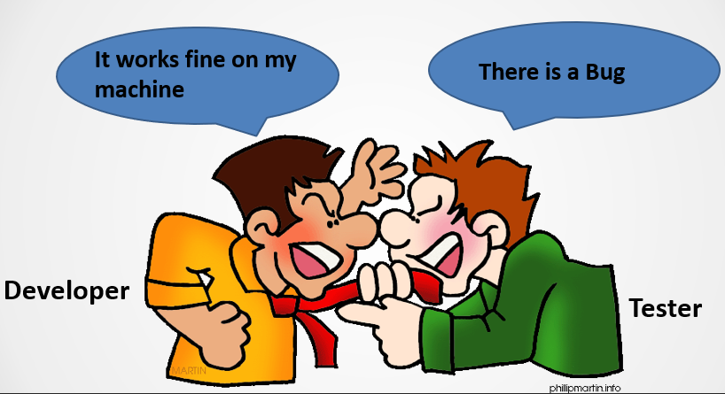
User Concerns

Slide 6
Benefits of containerization
Portable runtime environment
No need to worry about missing dependencies & packages
Run tests faster
Restrict CPU & Memory usage by containers.
Efficient, consistent & repeatable
Speed, reliability of CI & CD
Allows running multiple applications that need a different version of the base language/framework on a single host.
Allows you to test with other platforms like Linux/Unix on your Windows desktop.
Containers are isolated from one another, so you can easily run multiple containers on a single machine without worrying about any interference between them.

Slide 7
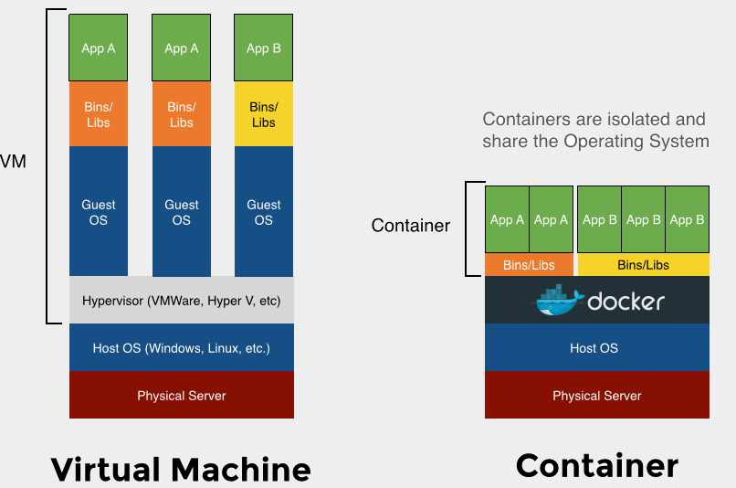
VMs vs Containers

Slide 8
VMs vs Containers
Virtual Machine | Container
Abstraction of physical hardware turning one server into many servers. | Abstraction at the app layer that packages code and dependencies together.
The hypervisor allows multiple VMs to run on a single machine. | Multiple containers can run on the same machine and share the OS kernel with other containers, each running as isolated processes in user space.
VMs are meant to run multiple applications, so a VM has multiple processes running. | Each container is purposed to run one application, so it only has a single process running in most of the cases.
Each VM includes a full copy of an operating system, the application, necessary binaries and libraries - taking up tens of GBs. | Containers package a light version of the OS and hence take up less space than VMs (container images are typically tens of MBs in size).
VMs can be slow to boot. | Containers are lightweight and fast to boot.

Slide 9
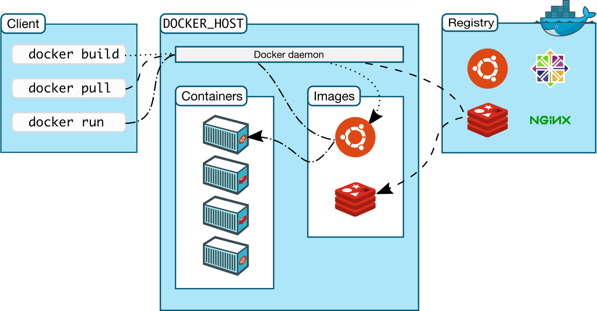
Docker architecture

Slide 10
Docker components
Core components:
Docker Daemon
Docker engine, runs on the host machine
Docker Client
CLI used to interact with the daemon
Workflow components:
Docker Image
Package containing the environment & your applications – in the form of a binary file.
Docker Container
Run-time instances created from images. Start, Stop, Run, Delete
Docker Registry
Public & Private repositories used to store images
Dockerfile
Automates image construction

Slide 11
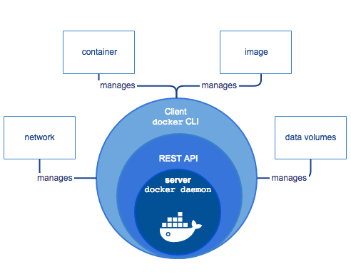
Docker architecture – component view

Slide 12
Installing Docker CE on Windows
Method 1 - Docker Desktop for Windows - https://docs.docker.com/docker-for-windows/install:
Both windows & linux containers
Get approval - http://shopping.fnfis.com/Shopping/Home ➔Risk Mgmt Approval Required ➔ Hypervisor Approval
Upon approval, create support ticket to:
Configure either the WSL2 Backend or Hyper-V backend as per the instructions mentioned in the above page
Enable BIOS-level hardware virtualization support
Download and install Docker Desktop for windows from the link in above page.
Method 2 - Docker on Ubuntu Hyper-V VM on Windows – only linux containers:
Get approval for Hyper-V - http://shopping.fnfis.com/Shopping/Home ➔Risk Mgmt Approval Required ➔ Hypervisor Approval
Upon approval, create employee support ticket to:
Enable Hyper-V and Containers Windows features
Enable BIOS-level hardware virtualization support in the BIOS settings.
Install Ubuntu VM using “Quick Create…” Option in Hyper-V.

Slide 13
Installing Docker CE on Training VM
You would have been provided a training VM using RHEL 8 and would have got root access.
Change to root using “dzdo su -“.
Now execute the following commands:
dnf config-manager --add-repo=https://download.docker.com/linux/centos/docker-ce.repo
dnf install https://download.docker.com/linux/centos/7/x86_64/stable/Packages/containerd.io-1.2.13-3.2.el7.x86_64.rpm
dnf install docker-ce
systemctl enable --now docker
docker version
docker run hello-world

Slide 14
Installing Docker CE on Training VM
Enable your user id to run docker commands as follows:
Switch to root using dzdo su -.
Edit /etc/group and update the line for docker group to include your user id. For e.g. “docker:x:983:e3018958”.
Logout and login again.
Test if you can run docker under your user id by executing “docker run hello-world”.
Install docker-compose as follows:
Switch to root using dzdo su -.
curl -L "https://github.com/docker/compose/releases/download/1.29.0/docker-compose-$(uname -s)-$(uname -m)" -o /usr/local/bin/docker-compose
chmod +x /usr/local/bin/docker-compose
Check if you can run docker-compose by going back to your user id shell and execute “docker-compose version”.

Slide 15
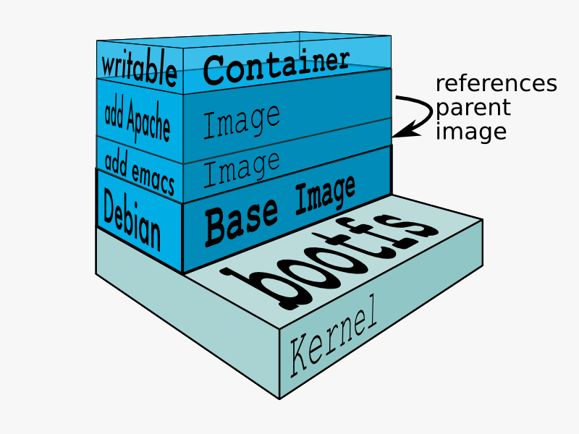
Docker images
Docker image is made up of file systems layered over each other, basically a tar file
A Docker base image is an OS user space minus the kernel
Base is a boot filesystem, bootfs uses a Union File System & root filesystem stays in read-only mode
UnionFS allows files and directories of separate file systems, to be transparently overlaid, forming a single coherent file system.
When a container is launched from an image, Docker mounts a read-write filesystem on top of any layers below

Slide 16
Working with containers
Ensuring Docker is ready - docker info
If docker service is not running, it can be started using - systemctl start docker.socket
Launch containers using docker run command
docker run -i -t ubuntu /bin/bash
-i = keeps STDIN open from the container
-t = assings a pseudo tty to the container
Once the container shell prompt is open, run the following commands:
hostname
cat /etc/hosts
ps –aux
apt-get update
apt-get install vim
exit

Slide 17
Working with containers
Container naming - docker run --name my_container -it ubuntu /bin/bash
Starting a stopped container - docker start my_container
Container id could also be used instead of container name.
Attaching current terminal to a running container - docker attach my_container
Launch containers in background
docker run --name my_web_server –d nginx
docker run --name my_daemon_container -d ubuntu /bin/sh -c ‘while true; do echo hello world; sleep 5; done’
Fetch logs of a container
docker logs my_daemon_container – Use -f option to follow the logs.
Stopping a container - docker stop my_daemon_container

Slide 18
Working with containers
List containers - docker ps or docker container ls
-a lists all containers, including stopped ones
-q shows only container ID
Deleting a container - docker rm my_daemon_container
Inspecting a container's processes - docker top my_daemon_container
Getting detailed information on containers
docker inspect <containerid>
docker inspect –f ‘{{ .NetworkSettings.IPAddress }}’ <containerid>
docker inspect --format=‘{{ .State.Running }}’<containerid>
docker inspect --format=‘{{json .State}}’ <containerid>
See https://docs.docker.com/config/formatting/ for a list of functions that could be used in the format string.

Slide 19
Working with containers
Run a command in a running container without attaching to it
docker exec my_daemon_container hostname
docker exec -it my_daemon_container /bin/sh – Launch a shell to inspect the container and execute arbitrary commands in it.
Display a live stream of container(s) resource usage statistics
docker stats [containerIDs]
Get real time events from the server - https://docs.docker.com/engine/reference/commandline/events
Filter events by object type - docker events --filter ‘type=[container|image|plugin|volume|network|daemon|service|node|secret|config]’
Filter events by event type type, using same “key” multiple times in the filter treats it as OR. This example displays events of type attach or die. - docker events --filter event=attach --filter event=die
Filter events by time range - docker events --since ‘1h’

Slide 20
Container port mapping
By default, the ports exposed on a container are accessible only from the host running the container.
To map a port on the container to a port on the host so that it is accessible from outside using the host ip address/name and host mapped port, the following options are available:
docker run -p 8080:80 nginx – Starts a container with the nginx image, mapping port 8080 on the host to the container port 80. Now the web server is accessible using http://<<hostname>>:8080.
docker run -P nginx – Same as above, only difference is that -P maps all exposed ports of a container to random ports on the host. Exposed ports means all ports declared with EXPOSE instruction.
docker run -p 192.168.1.100:8080:80 nginx – Starts a container with the nginx image, mapping port 8080 on the ip 192.168.1.100 of the host to the container port 80. Now the web server is accessible using http://192.168.1.100:8080.

Slide 21
Containers – Manage data
Refer https://docs.docker.com/storage .
By default all files created inside a container are stored on a writable container layer. This means that:
The data doesn’t persist when that container no longer exists, and it can be difficult to get the data out of the container if another process needs it.
A container’s writable layer is tightly coupled to the host machine where the container is running. You can’t easily move the data somewhere else.
Writing into a container’s writable layer requires a storage driver to manage the filesystem. The storage driver provides a union filesystem, using the Linux kernel. This extra abstraction reduces performance as compared to using data volumes, which write directly to the host filesystem.
Docker has two options for containers to store files in the host machine, so that the files are persisted even after the container stops: volumes and bind mounts.
If you’re running Docker on Linux you can also use a tmpfs mount. If you’re running Docker on Windows you can also use a named pipe.

Slide 22
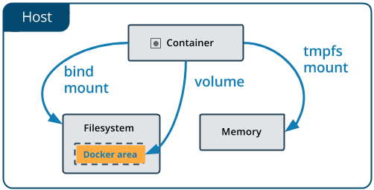
Containers – Manage data
Volumes are the preferred mechanism for persisting data generated by and used by Docker containers as they are managed by docker (/var/lib/docker/volumes).
In most of the cases, instead of persisting data in a container’s writable layer, using one of the above options is a better choice because it does not increase the size of the containers using it, and the persisted data continues to exist outside the lifecycle of a given container (except for tmpfs mounts).
Any type of mount can be mounted on a container using either the --mount option or the -v/--volume option of the docker run command. The --mount option is more verbose but also easy to understand and hence the recommended one.

Slide 23
Container – Manage data – bind mounts
A file or directory on the host machine is mounted into a container.
Bind mounts are very performant, but they rely on the host machine’s filesystem having a specific directory structure available.
You can’t use Docker CLI commands to directly manage bind mounts.
If you bind-mount into a non-empty directory on the container, the directory’s existing contents are obscured by the bind mount. This can be beneficial, such as when you want to test a new version of your application without building a new image. However, it can also be surprising, and this behavior differs from that of docker volumes.
Differences between --mount and -v options:
If you use --mount to bind-mount a file or directory that does not yet exist on the Docker host, Docker does not automatically create it for you, but generates an error.
If you use -v or --volume to bind-mount a file or directory that does not yet exist on the Docker host, -v creates the endpoint for you. It is always created as a directory.

Slide 24
Container – Manage data – bind mounts
Two ways
--mount option
docker run -d --name devtest --mount type=bind,source="$(pwd)"/target,target=/app nginx:latest
docker run -d --name broken-container --mount type=bind,source=/tmp,target=/usr nginx:latest – results in error as the container file system is obscured by the host directory.
docker run -d --name devtest --mount type=bind,source="$(pwd)"/target,target=/app,readonly nginx:latest – mounts as read only, container cannot write to it.
-v or --volume options
docker run -d --name devtest -v "$(pwd)"/target:/app nginx:latest
docker run -d --name broken-container -v /tmp:/usr nginx:latest – results in error as the container file system is obscured by the host directory.
docker run -d --name devtest -v "$(pwd)"/target:/app:ro nginx:latest – mounts as read only, container cannot write to it.
Use docker inspect container-name to verify that the bind mount was created correctly. Look for the Mounts section.

Slide 25
Container – Manage data – volumes
Docker volumes are managed by docker using the docker volume command.
Volumes have several advantages over bind mounts:
Volumes are easier to back up or migrate than bind mounts.
You can manage volumes using Docker CLI commands or the Docker API.
Volume drivers let you store volumes on remote hosts or cloud providers, to encrypt the contents of volumes, or to add other functionality.
New/Empty volumes can have their content pre-populated by a container.
Manage volumes
Create a volume with specified name - docker volume create <<volume-name>>
List details of a volume such as its mount directory - docker volume inspect <<volume-name>>
Create an anonymous volume, automatically generating a unique name - docker volume create
List all volumes - docker volume ls

Slide 26
Container – Manage data – volumes
Manage volumes
Remove a volume - docker volume rm <<volume-name>>
Remove all unused volumes - docker volume prune
Launching container with volumes – 2 ways --mount and -v options.
docker run -v test-vol:/tmp/testvol -d nginx
If volume test-vol exists, start the container mounting the volume in the /tmp/testvol directory of the container.
If volume test-vol does not exist, create the volume and start the container mounting the volume in the /tmp/testvol directory of the container.
docker run --mount source=test-vol,target=/tmp/testvol -d nginx – same as above.
docker run --mount type=volume,source=test-vol,target=/tmp/testvol -d nginx – same as above.
docker run -d --mount source=nginx-vol,target=/usr/share/nginx/html,readonly nginx or docker run -d -v nginx-vol:/usr/share/nginx/html:ro nginx – same as above, but mounts the volume as read only.

Slide 27
Container – Manage data – volumes
docker run -d -v /usr/share/nginx/html nginx or docker run -d --mount target=/usr/share/nginx/html nginx – Creates and uses an anonymous volume. The anonymous volume does not get automatically deleted when the container stops.
docker run -d --rm -v /usr/share/nginx/html nginx or docker run -d --rm --mount target=/usr/share/nginx/html nginx – Creates and uses an anonymous volume. When the container stops, it is removed and the anonymous volume is also removed.
When a volume being mounted to the container is empty, but the container has some files in the mount path, docker automatically copies the files in the container to the volume.
If the volume being mounted is not empty and the container has some files in the mount path, the container files get obscured by the volume’s files.

Slide 28
Container – Manage data – tmpfs mounts
If your container generates non-persistent state data, consider using a tmpfs mount to avoid storing the data anywhere permanently, and to increase the container’s performance by avoiding writing into the container’s writable layer.
A tmpfs mount is temporary, and only persisted in the host memory. When the container stops, the tmpfs mount is removed, and files written there won’t be persisted.
Available only on Linux.
Unlike volumes and bind mounts, tmpfs mounts cant be shared between containers.
Two ways to specify tmpfs mounts in docker run command - --tmpfs and --mount options.
Examples:
docker run -d --mount type=tmpfs,destination=/app nginx or docker run -d --tmpfs /app nginx
docker container inspect <<container-name>> - Check the “Mounts” section in the output.

Slide 29
Container – Manage data – tmpfs mounts
tmpfs options – can be specified only with the --mount option.
docker run -d --mount type=tmpfs,destination=/app,tmpfs-mode=1770 nginx – Sets permissions for newly created files in the mount to 1770 – the first “1” is the sticky bit while others are standard permissions as expected by chmod command.
docker run -d --mount type=tmpfs,destination=/app,tmpfs-size=1000000 nginx – Limits the size of the tmpfs mount to the specified number of bytes.

Slide 30
Building images interactively
Build an image from a running container. Not the preferred method.
Start a container using the base image you want to work with.
Perform needed installation and configuration to get your application up and running.
Use “docker commit” command to create an image out of the container.
Example:
Prepare the container
docker run --name myapp -it ubuntu
apt install vim
vim testfile.txt
exit
Inspect changes – docker diff myapp
Commit to create the image – docker commit myapp myappimg:1.0.0
Test by starting a container – docker run -it myappimg:1.0.0

Slide 31
Building images using Dockerfile
A Dockerfile is a text file containing a series of commands to assemble an image, used to automate building images using the docker build command.
docker build command builds an image from a Dockerfile and a context. The context is the set of files at a specified location PATH or URL - where PATH is a directory on your local filesystem and URL is a Git repository location.
Build is run by Docker daemon, not by CLI. Build process first sends the entire context recursively to the daemon. It’s best to start with an empty directory as context and keep your Dockerfile in it. Add only the files needed for building the Dockerfile. Do not use your root directory, /, as the PATH as it causes the build to transfer the entire contents of your hard drive to the Docker daemon.
If you skip specifying the path to the Dockerfile using the -f option of docker build, it looks for a file named ‘Dockerfile’ at the root of the context.

Slide 32
Building images using Dockerfile
Docker builds the image and stores it locally (on the docker daemon host), generating a unique image id.
To upload your image to a docker registry, you must use the docker push command which would also need your images to be uniquely tagged.
To specify one or more tags for the image when building it, use the -t option of docker build. To tag an image after it is built, use the docker tag command.
docker build examples:
docker build . – Use current dir as context, ‘./Dockerfile’ and no tag for the image.
docker build -f myappdockerfile /usr/build/myapp – Use /usr/build/myapp as context, ‘/usr/build/myapp/myappdockerfile’ as Dockerfile and no tag for image.
docker build -t myapp:1.0.0 -t myapp:latest . – Use current dir as context, ‘./Dockerfile’ and tag the image with 2 tags - “myapp:1.0.0” and “myapp:latest”.

Slide 33
Building images using Dockerfile
docker build examples:
docker build -t myapp:1.0.0 http://server/ctx.tar.gz
Send URL to docker daemon.
Docker daemon downloads and extracts the file to a fresh temporary directory using it as a context, uses ‘Dockerfile’ in the root of this context dir for the build and tags the image as “myapp:1.0.0”.
docker build https://github.com/docker/labs.git#master:beginner/static-site -t nginx-static-site-git – See https://docs.docker.com/engine/reference/commandline/build/#git-repositories for more examples.
Pull the repository into a temporary directory on localhost. “master” is the branch to be checked out and “beginner/static-site” is the context directory in the cloned repo.
Then the context directory is sent to the Docker daemon as the context.
The docker daemon uses “beginner/static-site/Dockerfile” for the build and tags the image as nginx-static-site.
docker build https://github.com/docker/labs.git - Same as previous, but uses master branch and the root of the repo as the context dir.

Slide 34
Dockerfile instructions
A Dockerfile has instructions laid out sequentially in the order of execution. https://docs.docker.com/engine/reference/builder/ .
A line starting with # is treated as a comment, # anywhere else is not a comment.
Each line of instruction is of the format “INSTRUCTION arguments”. The instruction is not case-sensitive, but it’s a convention to keep it in uppercase.
FROM <image>[:<tag>] - A valid Dockerfile must start with a FROM instruction. It sets the Base Image for subsequent instructions.
RUN <command> - known as shell form - Executes the command in the image using a shell. For shell, by default /bin/sh -c is used on Linux and cmd /S /C is used on windows.
RUN ["executable", "param1", "param2"] - known as exec form - Executes the command in the image without using a shell.

Slide 35
Dockerfile instructions
CMD & ENTRYPOINT instructions
Like RUN, both have 2 forms – the shell form which executes within a shell and the exec form that executes without a shell.
Either of them can be used to specify the process to be executed in the container when its started.
CMD command (both exec and shell form) can be fully overridden by passing additional command line arguments in the docker run command.
ENTRYPOINT command (both exec and shell form) can only be fully overridden using the "--entrypoint“ argument to the docker run command.
When ENTRYPOINT is used in exec form, any additional command line arguments in the docker run command get appended to the end of the array.
When ENTRYPOINT is used in shell form, any additional command line arguments are ignored.
If you use multiple CMD instructions, only the last one takes effect.
If you use multiple ENTRYPOINT instructions, only the last one takes effect.

Slide 36
Dockerfile instructions
ADD/COPY [--chown=<user>:<group>] <src>... <dest>
Copy one or more files/directories from build context into the image.
ADD allows you to download from a URL and copy into the image and also takes care of extracting archives.
WORKDIR <directory>– change directory to specified one in image for commands following the WORKDIR command.
USER <user>[:<group>] or USER <UID>[:<GID>]
Change the user and optionally the user group to use for commands following it.
ENV <name>=<value>… - Sets environment variables for commands following it as well as containers started from the image.
ARG <name>[=<default-value>]
defines a build time variable whose value can be passed using the --build-arg <varname>=<value> flag.
Its value is available only at build time from the time the ARG instruction is specified, not before that.

Slide 37
Dockerfile instructions
ENV vs ARG
Both are available at build time, but ENV variables are also available at runtime.
ENV variable values cannot be changed at build time using any argument to the docker build command while ARG can.
ENV variables can be modified when starting the container using the docker run --env <key>=<value> argument.
VOLUME <directory>…
Creates a mount point with the specified name and marks it as holding externally mounted volumes from native host or other containers.
The above syntax does not specify the host directory. When launching containers, if a source volume/bind mount is not specified to be mounted in that mount point, docker will create an anonymous volume.
Any data written to the volume during image build time is discarded and not available to the containers.
Its recommended for images to declare volumes for directories where they would be writing persistent data like logs, data, etc.

Slide 38
Dockerfile instructions
SHELL ["executable", "parameters"] - allows the default shell used for the shell form of commands to be overridden.
.dockerignore file – at root of context to specify files to exclude/include from build context.
Exclude files from build context:
# comment
*/temp*
!*/tempa – Removes the file from the exclusion list.
*/*/temp*
temp?
Include only specified files:
*
!target/*
!a/b/c

Slide 39
Dockerfile instructions
EXPOSE <port-no>[/<protocol>…]
Functions as a documentation between the image creator and image user, about which ports are intended to be published. To publish the port when running the container, use the -p flag on docker run to publish and map one or more ports, or the -P flag to publish all exposed ports and map them to high-order ports.
Dockerfile examples
Multi-stage build examples

Slide 40
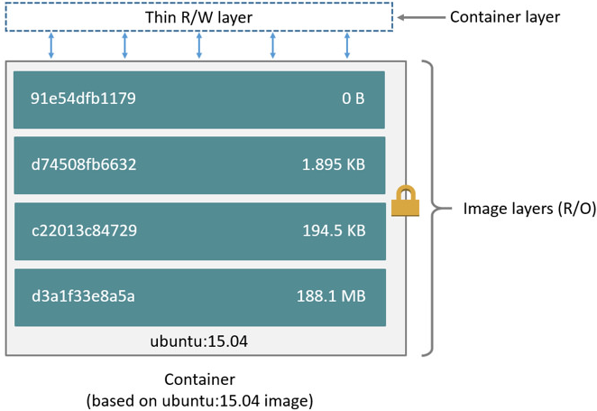
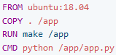
Image Layers
A Docker image is built up from a series of layers. Each layer represents an instruction in the image’s Dockerfile. Each layer except the very last one is read-only. Refer https://docs.docker.com/storage/storagedriver/#images-and-layers

Slide 41
Image Layers
Each layer is only a set of differences from the layer before it.
The layers are stacked on top of each other.
When you create a new container, you add a new writable layer on top of the underlying layers. This layer is often called the “container layer”.
All changes made to the running container, such as writing new files, modifying existing files, and deleting files, are written to this thin writable container layer.
The storage driver presents the files from all layers as a single filesystem inside the container. Files in a higher layer obscure files with the same name and path in the layers below it.
The major difference between a container and an image is the top writable layer. All writes to the container that add new or modify existing data are stored in this writable layer. When the container is deleted, the writable layer is also deleted. The underlying image remains unchanged.

Slide 42
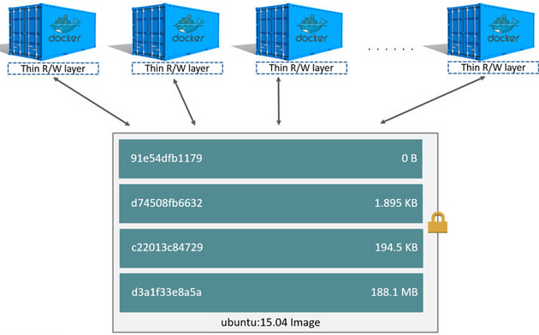
Image Layers
Because each container has its own writable container layer, multiple containers can share access to the same underlying image and yet have their own data state.
For multiple containers to have shared access to same data, store it in a Docker volume and mount it into the containers.
Copy-on-write is a strategy of sharing and copying files for maximum efficiency. If a file or directory exists in a lower layer within the image, and another layer (including the writable layer) needs read access to it, it just uses the existing file. The first time another layer needs to modify the file (when building the image or running the container), the file is copied into that layer and modified. This minimizes I/O and the size of each of the subsequent layers.

Slide 43
Container size
To view the approximate size of a running container, use the docker ps -s command. Two different columns relate to size.
Size – the amount of data (on disk) that is used for the writable layer of each container.
Virtual size – the amount of data used for the read-only image data used by the container plus the container’s writable layer size. Multiple containers may share some or all read-only image data. Two containers started from the same image share 100% of the read-only data, while two containers with different images which have layers in common share those common layers. Therefore, you can’t just total the virtual sizes. This over-estimates the total disk usage by a potentially non-trivial amount.
Total disk space used by all the running containers on disk is some combination of each container’s size and the virtual size values. If multiple containers started from the same exact image, the total size on disk for these containers would be SUM of size of containers plus one image size (virtual size - size).

Slide 44
Registries
Registry acts as the repository of images from where images can be downloaded and uploaded.
An image identifier used in any docker command is of the following form – [<registry>/]NAME[:TAG|@Digest]. If registry is not specified, it defaults to docker.io which is another name for docker hub. If TAG is not specified, default is latest.
Docker hub is a public registry which contains lot of images – both public and private. Public images can be pulled and used without any credentials. Private images can be used only if your credentials have been provided the access to them.
To push your own images to docker hub, you need docker hub credentials. With free access to docker hub, all images pushed by you live in a repository named after your user id and are public. With free access, you also have the option of only one private repository. Images that you push to docker hub are identified as [<registry>/]<docker hub id>/NAME[:TAG|@Digest].
Use “docker login” or “docker login docker.io” command to specify the credentials to be used for docker hub. Credentials will get saved in base64 encoded format in ~/.docker/config.json.

Slide 45
Registries
See https://docs.docker.com/engine/reference/commandline/login/#credentials-store on configuring credential manager applications to store the password in encrypted format.
Typically every IT organization will have it’s own private registry where it maintains proprietary images. For FIS, it is at https://*.docker.fis.dev. docker.fis.dev is Jfrog artifactory with docker support. To access it, the URL is <artifactory-repo-name>.docker.fis.dev. You need to login using “docker login <artifactory-repo-name>.docker.fis.dev” to both pull and push images to it. You must have access to the specified artifactory repo.
Example
docker login <artifactory-repo-name>.docker.fis.dev
docker build . -t <artifactory-repo-name>.docker.fis.dev/my-hello-world:1.0.0
docker push <artifactory-repo-name>.docker.fis.dev/my-hello-world:1.0.0
docker rmi <artifactory-repo-name>.docker.fis.dev/my-hello-world:1.0.0
docker pull <artifactory-repo-name>.docker.fis.dev/my-hello-world:1.0.0
docker logout <artifactory-repo-name>.docker.fis.dev

Slide 46
Container restart policy
Restart policy specifies when to restart a stopped container, specified using the --restart option of docker run command.
Default value is no, other values are – on-failure, always, unless-stopped.
The next table documents the behavior of all restart policies in 3 container stop scenarios
The container runs to completion with success exit code.
The container runs to completion with failure exit code.
The container is manually stopped via docker CLI.
These scenarios are further divided into 2 sub categories – one when the docker daemon is still up and running and 2nd when the docker daemon is restarted.

Slide 47


Container restart policy
Restart policy | Docker daemon | On completion – success | On completion – failure | On stopping via docker command
no | running
no | restarted
on-failure | running
on-failure | restarted
always | running
always | restarted
unless-stopped | running
unless-stopped | restarted

Slide 48
Container resource constraints
By default, container’s access to host machine’s CPU cycles and memory is unlimited.
CPU Restrictions
Restrict number of cores with --cpus option – For e.g. if host machine has two CPUs and you set --cpus="1.5", the container is guaranteed at most 1.5 CPU
With --cpuset-cpus, specify the CPUs or cores a container can use. Examples 0-3, “1,3”.
With --cpu-shares, you can give a container access to higher or lesser number of host’s CPU cycles with a value greater or less than the default of 1024 to increase or reduce the container’s weight. This is really applied only if the CPU is constrained.
Memory constraints
“-m” or “--memory=“ specifies the memory constraint e.g. 4m, 1g, etc. Minimum 4m.
“--memory-swap=“
Set to -1 for unlimited swap
If unset or set to 0, swap memory is the same as the --memory setting.
The value is actually a total of physical memory and swap memory. So specifying same value as --memory means no swap.

Slide 49
Container & networks
“docker network” command is used to create and manage networks for docker.
By default docker creates 3 networks:
Named “host” with “host” network driver.
Named “bridge” with “bridge” network driver. Containers are attached to this by default.
Named “none” with “none” network driver.
User-defined networks can be created using the “docker network create” command.
Host networks – use host network stack and there is no need to map ports.
None networks
Containers’ ports cannot be exposed for outside access.
Containers on none network don’t have any network access at all.

Slide 50
Container & networks
Bridge networks
Containers connected to a bridge network can directly communicate to other containers on the same bridge.
Containers connected to a bridge network cannot directly communicate to containers not attached to that bridge.
User-defined vs default bridge networks
Containers attached to default bridge network can directly communicate to other containers on the same bridge using their IP Address but not by their container id/container name.
Containers attached to user defined bridge network can directly communicate to other containers on the same bridge using their IP Address/container id/container name.
Containers can be attached to a network by specifying the “--network <name>” option of the “docker run” command.
Running containers can be connected to additional networks using the “docker network connect <network-name> <container>” command.

Slide 51
Docker compose
Compose is a tool for defining and running multi-container Docker applications - https://docs.docker.com/compose/ .
With Compose, you use a YAML file to configure your application’s services. Then, with a single command, you create and start all the services from your configuration.
Works with services. A service is an abstraction on top of containers.
Docker compose features
Multiple isolated environments on a single host
Preserve volume data when containers are created
Only recreate containers that have changed
Scale a service up or down by increasing number of containers for the service.
Restrict network access between services. For e.g. “front-end” service can access only “middle-tier” service and “middle-tier” service can access only “db-service”. But any other access between the services should be denied.

Slide 52
Docker compose
Docker compose commands
All docker-compose commands listed below use the docker-compose.yml file in current directory by default. Use -f option to specify a different file name (including path) instead of docker-compose.yml.
docker-compose up – Builds images if needed, creates containers if needed and starts the containers. They are executed in foreground. Use “-d” option to execute them in detached mode i.e. background.
docker-compose start – Only starts containers. If containers were not created or were removed, it throws errors as it does not take care of creation.
docker-compose stop – Stops the containers that were started with “up” using the docker-compose.yml in current directory.
docker-compose down – Same as docker-compose stop, but also removes the containers.
docker-compose run web env – Executes the specified command “env” on the container for “web” service.
docker-compose logs – Shows logs of all containers.
docker-compose logs web – Shows logs of the container for the “web” service.

